Slide 1

GPU-accelerated
Cardiac Electrophysiological Simulation
Milestone 1I
Zirui Zang (zzang@seas.upenn.edu) 20211117

Slide 2
Project Progress
Preprocessed Data
Data Handler
Compute Kernels
Visualizer
Deployment & Testing
Finished:
Output Matlab data to JSON, and import into C++ environment.
Adopting the HW1 visualizer to plot the model geometry and output result.
On-going:
Coding the CPU version simulation with Eigen library (Still have issues).

Slide 3
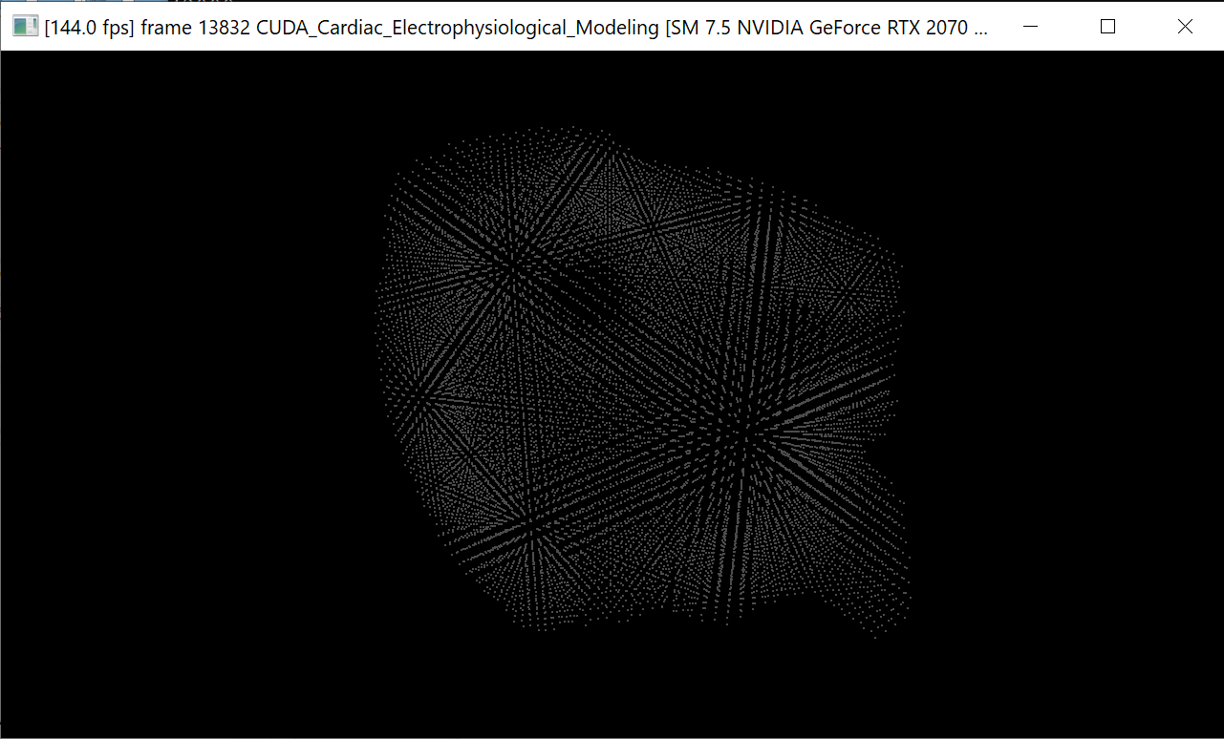
Model Geometry

Slide 4
Planned Performance Analysis & Deployments
We will analyze three different versions of compute kernels and compare with the reference Matlab version:
CPU version, based on C++ Eigen library (Almost done)
GPU naive version
GPU optimized version, with expected memory and other optimizations.
We will deploy the simulator in three different platforms:
Server platform w/ RTX A5000 GPU (x64 Linux compile)
Workstation platform w/ RTX 2070s GPU (x64 Windows compile)
Embedded platform w/ Nvidia Jetson Xavier NX (Arm Linux compile)

